Slide 1
Socket IO
Setup step by step

Slide 2
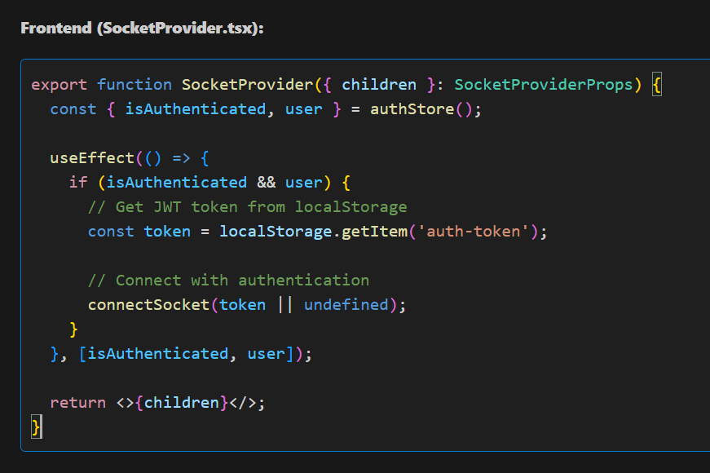
SocketProvider

Slide 3
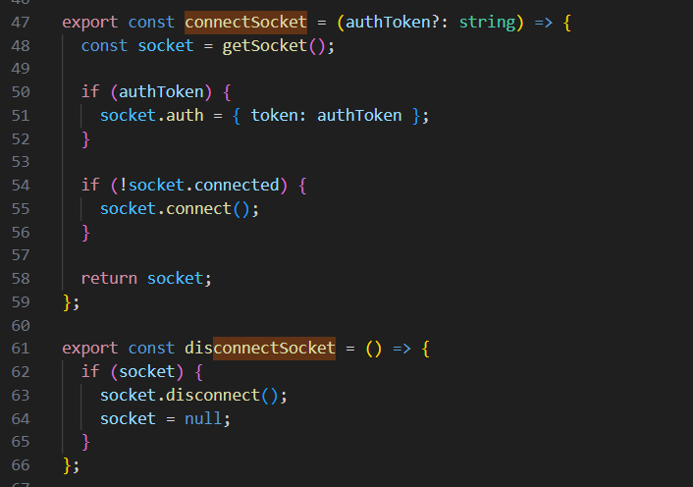



connectSocket
It attaches your JWT (or any token) to the socket handshake.
it will send this token to the server automatically,
inside the authentication payload.

Slide 4
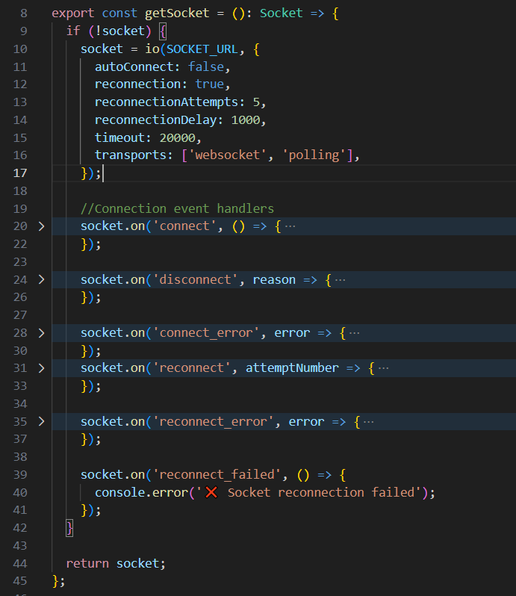
GetSocket()

Slide 5
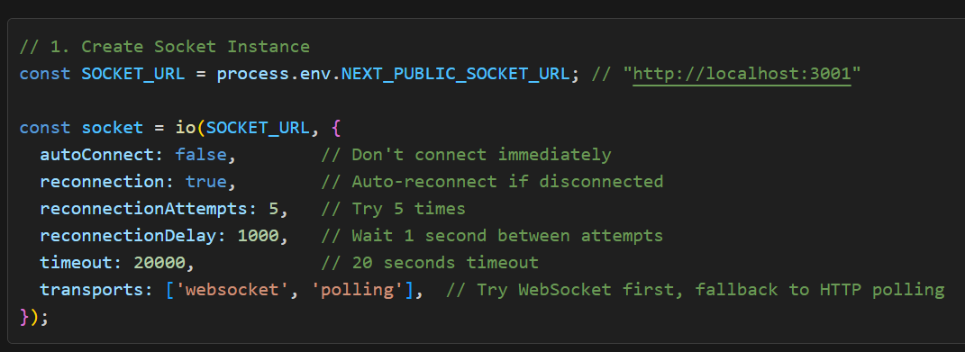
Phase 1 – Initial Setup ( Frontned)

Slide 6
This object allows you to:
socket.connect() → manually connect
socket.emit(event, data) → send events
socket.on(event, callback) → listen for events
socket.disconnect() → disconnect

Slide 7
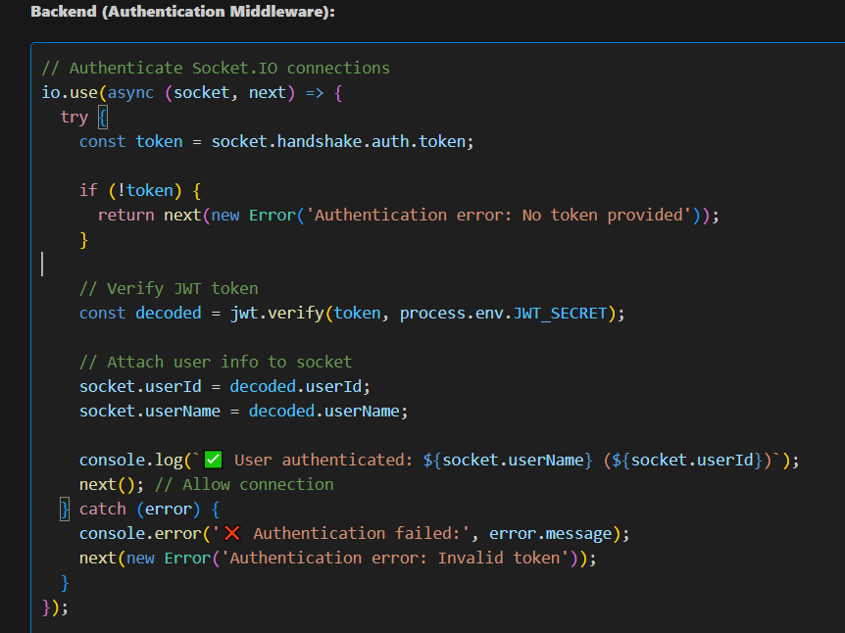
Auth middleware (backend)

Slide 8
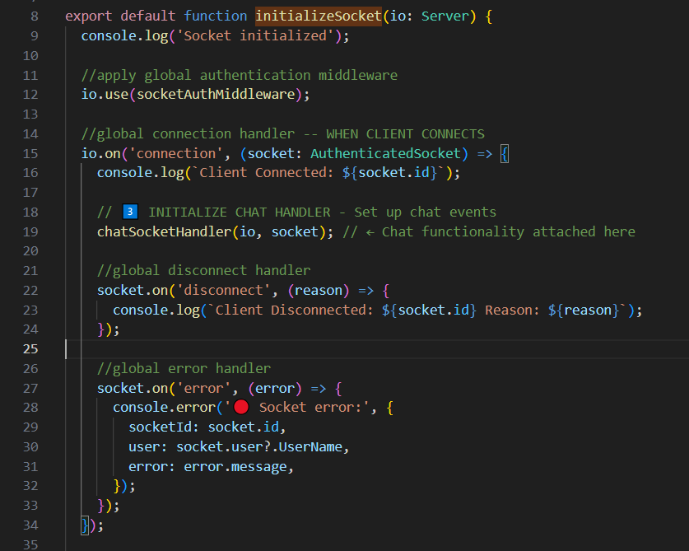
InitializeSocket()

Slide 9
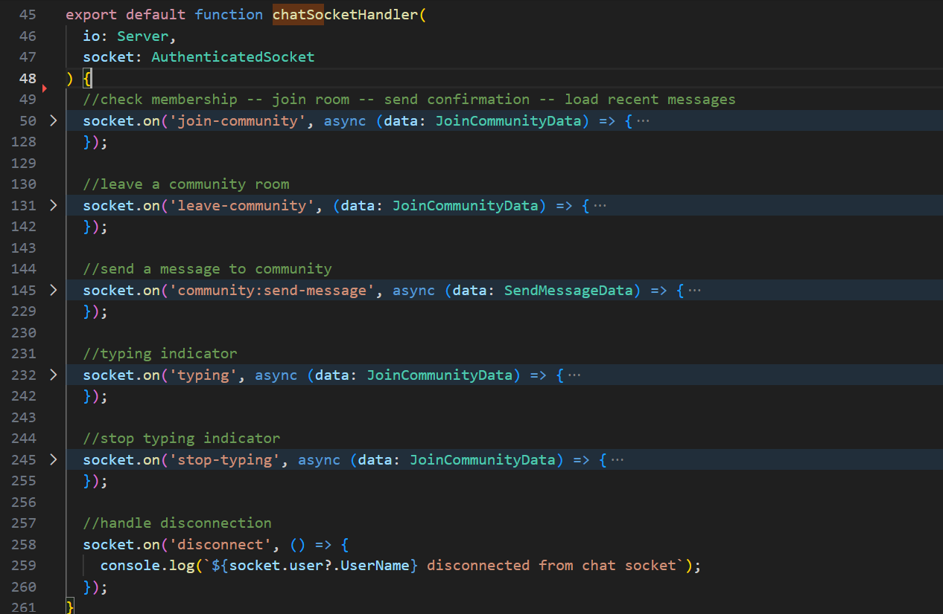
(Backend)} chatSocketHandler
Now the socket is “listening” for these events.

Slide 10
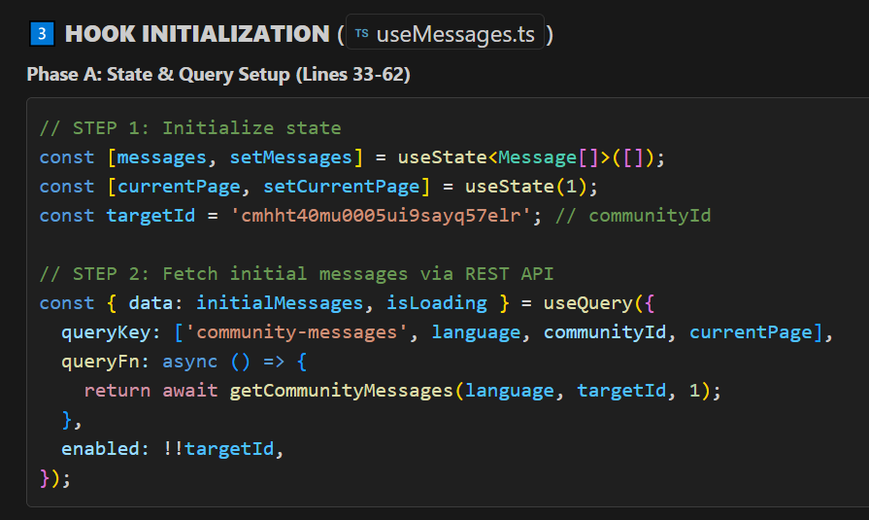
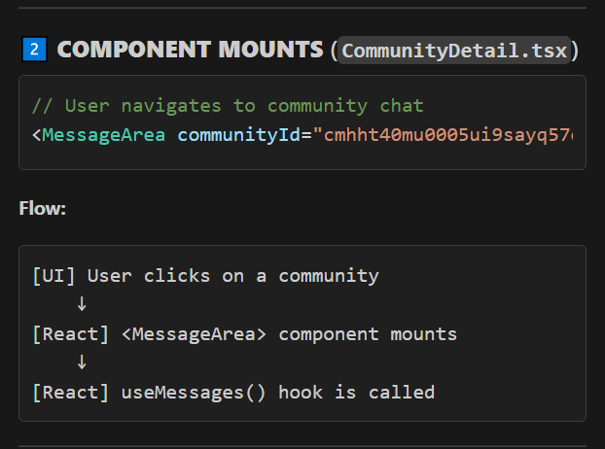
Frontend---when community is clicked
We use REST for loading existing messages.
We use Socket.IO for sending messages instantly without API calls.

Slide 11
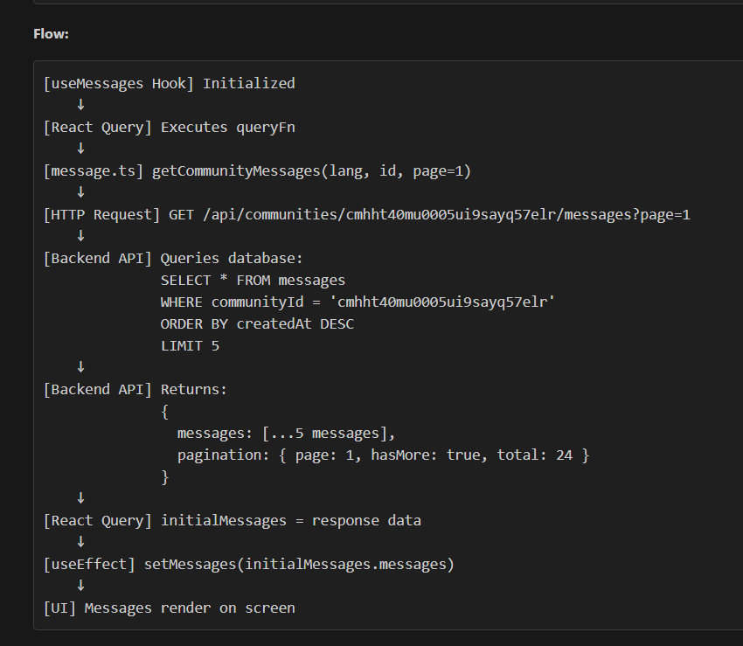
Flow
Frontend to backend response

Slide 12
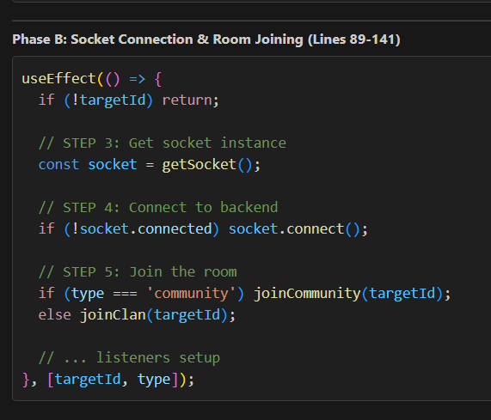
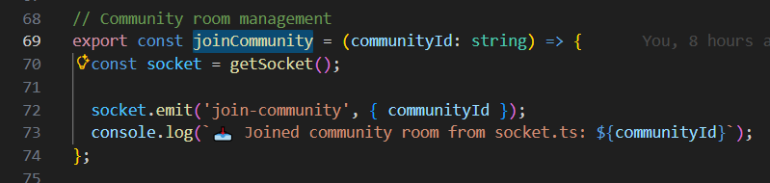
Join room process

Slide 13
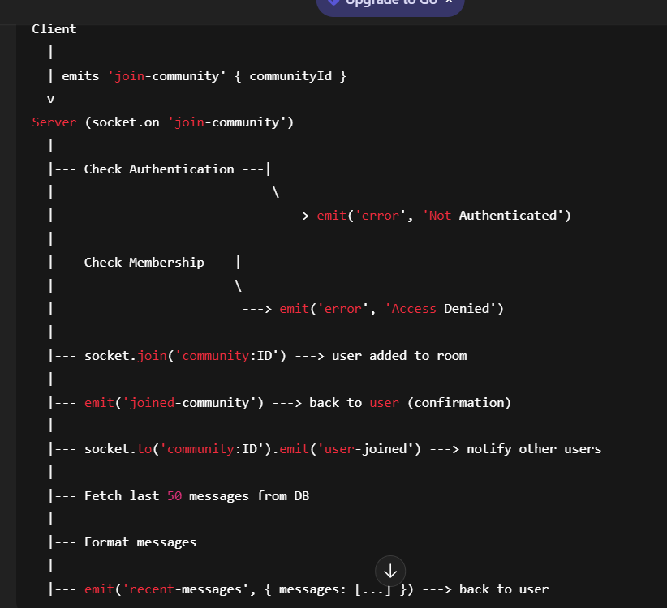
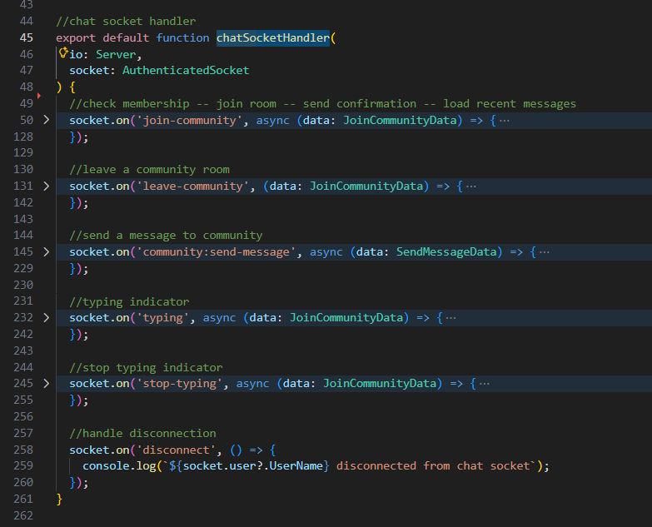
Backend listener for (join-community)
INSIDE chatSocketHandler function

Slide 14
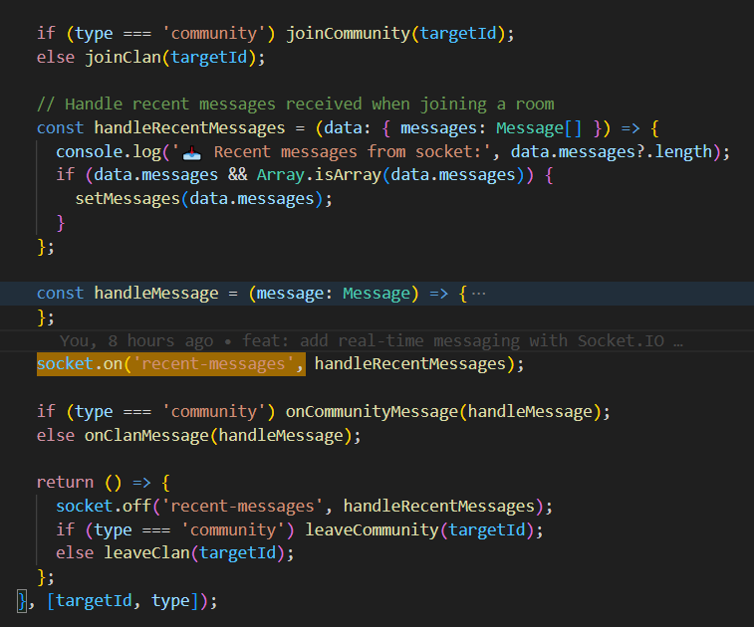
Frontend listener for (recent-messages)
UseMessage.ts

Slide 15
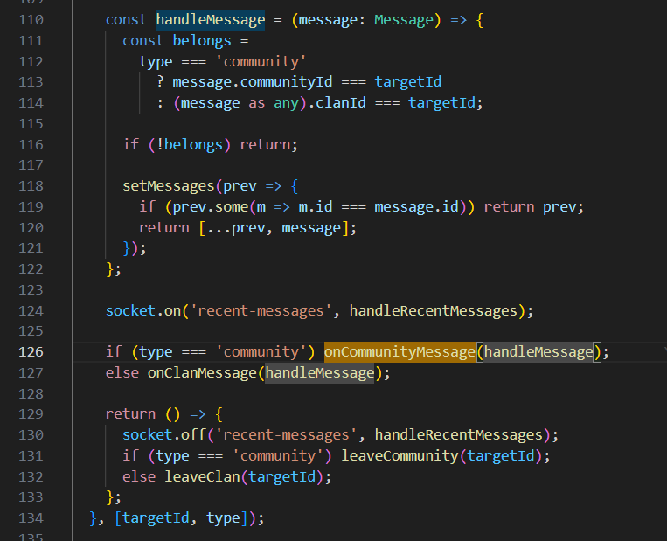
Frontend listener for (recent-messages)
handleMessage is the function that handles incoming messages:
UseMessage.ts
So, any new message in this community is pushed into the messages state.

Slide 16
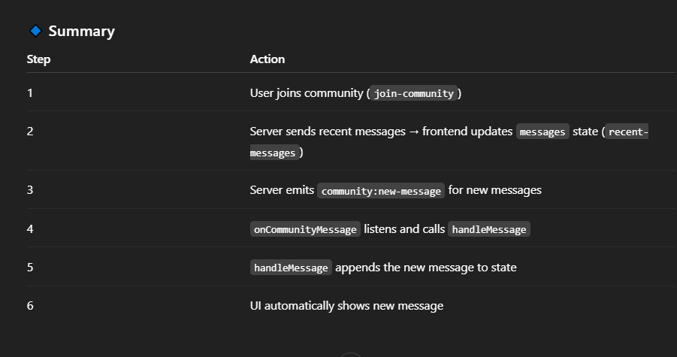
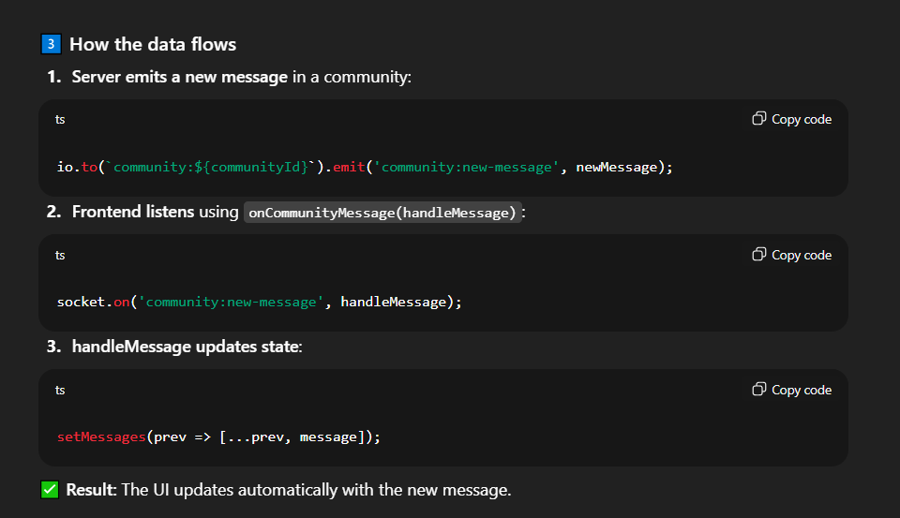
Flow of recent message showing
(server emits and frontend listens—all while joining rooom)

Slide 17
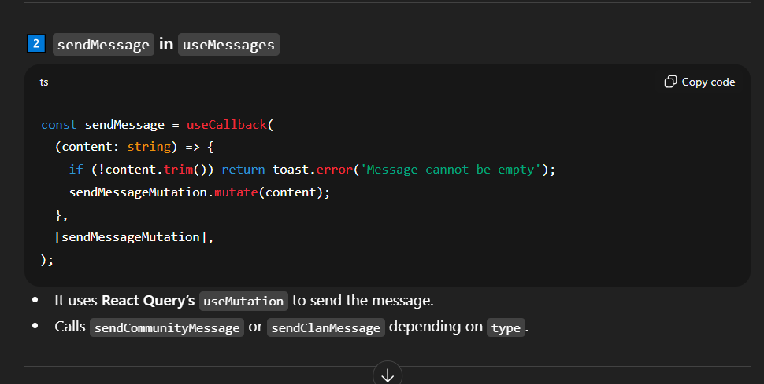
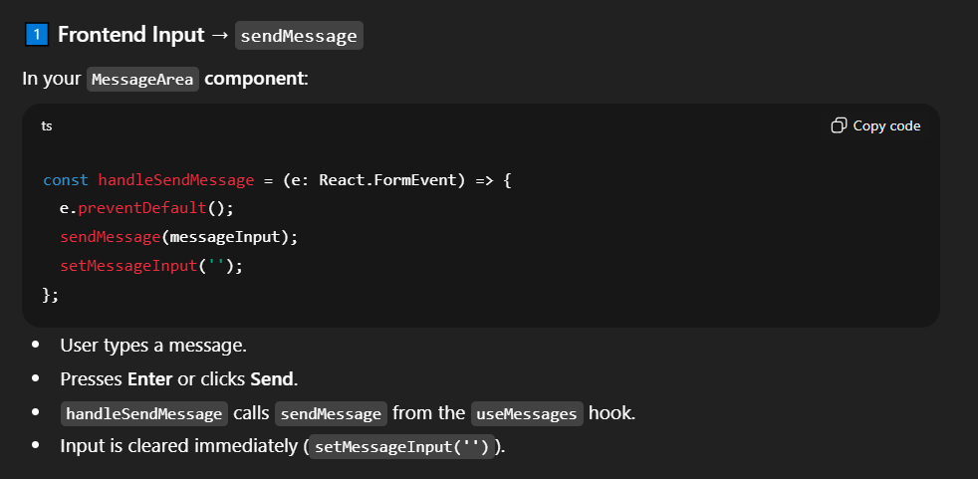
How send message work ( from messageArea to useMessage)

Slide 18
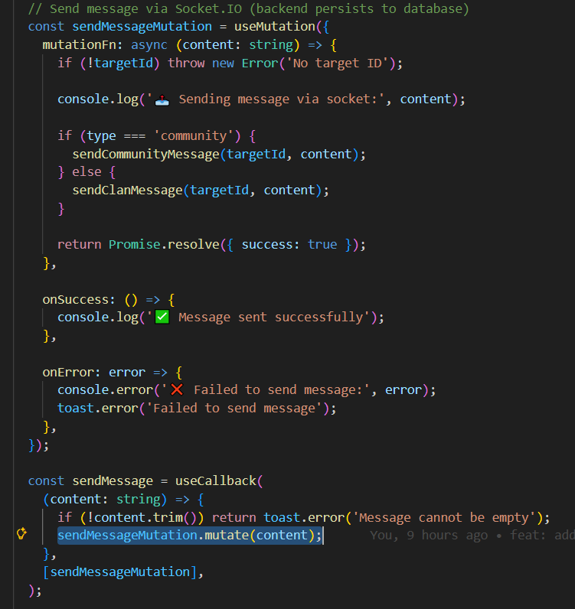
UseMessage.ts
targetId is derived inside the hook from the props you pass: communityId or clanId.
So even if you don’t pass it explicitly to sendMessageMutation, it has access to targetId because of closure.
💡 Closure in JS:
Functions inside a scope “remember” variables from their outer scope. Here:
sendMessageMutation.mutate(content) calls mutationFn.
mutationFn can still access targetId because it’s defined in the same hook scope.
So as long as you call useMessages({ communityId, clanId, type }), targetId is available inside the mutation function.

Slide 19
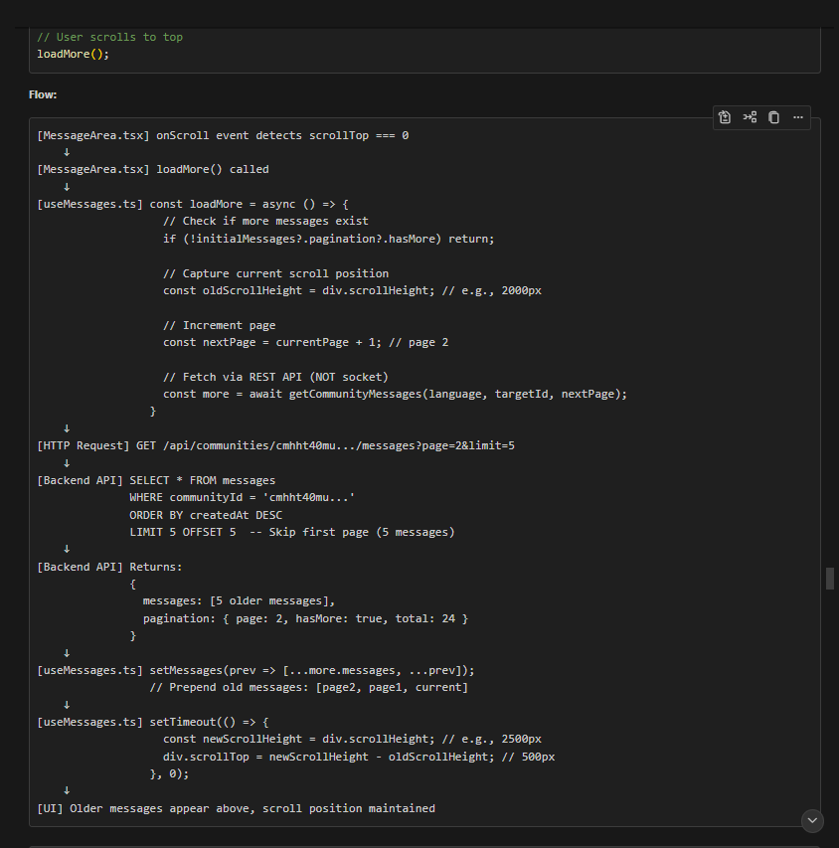
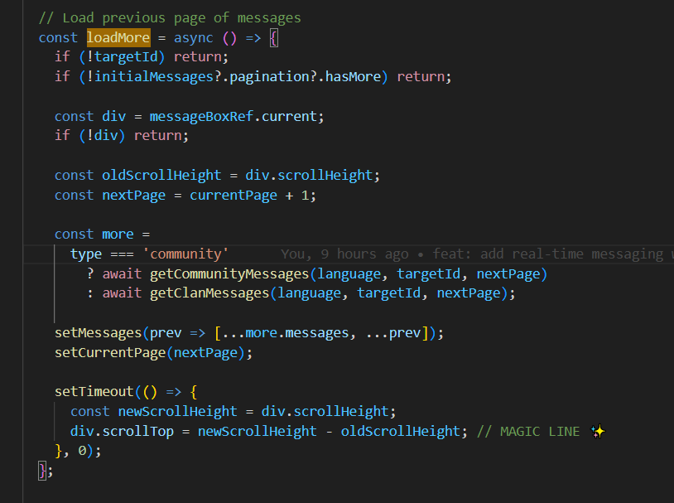
LoadMore function

Slide 20
LoadMore function
Purpose of loadMore function:
Loads previous messages (pagination) when user scrolls up.
Keeps chat scroll position stable so it doesn’t jump.
Key points to remember:
Checks if targetId exists and if there are more messages to load.
Fetches next page of messages from API (getCommunityMessages / getClanMessages).
Prepends new messages to the existing messages state.
Uses scroll height calculation to maintain scroll position (oldScrollHeight → newScrollHeight).
Triggered when user scrolls to top of the chat container.
It ensures infinite scroll for older messages without breaking the chat view.

Slide 21
Workingstructure flow
┌──────────────┐
│ FRONTEND │
│ user opens │
│ community chat │
└──────┬────────┘
│ joinCommunity()
v
┌──────────────┐
│ BACKEND │
│ user joins │
│ load last 50 │
└──────┬────────┘
│ emit("recent-messages")
v
┌──────────────┐
│ FRONTEND │
│ socket.on("recent-messages") → load old msgs
└──────┬────────┘
User sends new message
│
v
┌──────────────┐
│ BACKEND │
│ save to DB │
│ emit("community:new-message") │
└──────┬────────┘
│
v
┌──────────────┐
│ FRONTEND │
│ socket.on("community:new-message") → add new msg
└──────────────┘

